Slide 1
PREDICTIVE MODEL
British Airways Customer Reviews

Slide 2
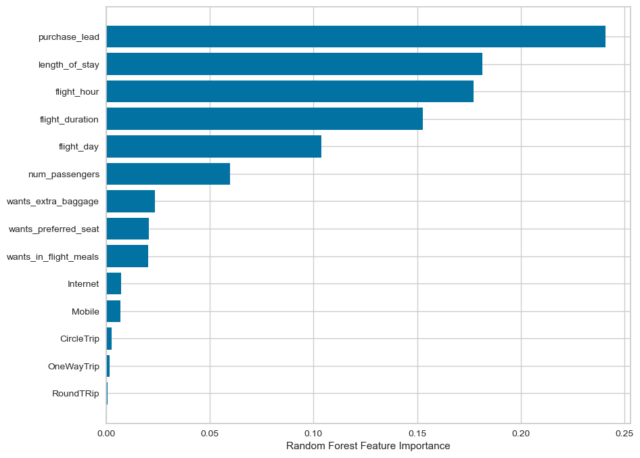
Results
Recall Rate
57%
Precision
62%
Accuracy
62%
These factors determine whether a customer will choose to book the flight or not.
There's a 66% probability of accurately predicting true incomplete bookings.
predicted as actually completed bookings out of all successfully completed bookings.
Accuracy of the model predicting successful or incomplete booking is 62%
We are focused on improving the accuracy of predicting successful bookings. An imbalanced dataset tends to yield higher accuracy but does not effectively predict successful bookings.
To address this, the dataset was balanced with 8,000 labeled as incomplete bookings and 7,000 as complete bookings.

